Slide 1
HEART ATTACK RISK PREDICTION USING MACHINE LEARNING TECHNIQUES
18251A0573 – K. Pranavi
18251A0577 – M. Sri Vidya
18251A0595 – Brahmani. Ch
18251A05B6 – S. Manasa

Slide 2
Table of contents
01
04
02
05
03
06
Problem Statement
Flow Chart
Dataset
ML Algorithms
Features
Result

Slide 3
Introduction
Problem statement:
A model to predict whether the patient has a future risk of developing a heart attack using ML techniques.
Machine learning (ML) can bring an effective solution for decision making and accurate predictions

Slide 4
Dataset

Slide 5

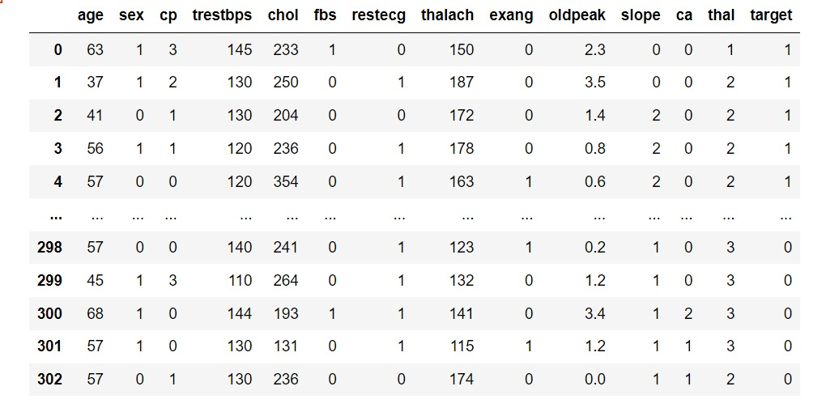
Epidemiology
Heart.csv Dataset
Despite being red, Mars is actua cold place. It's full of iron oxide dust, which gives the planet its reddish cast

Slide 6
Features.
Age
Gender
Chest Pain Type (cp):
Typical Angina(0)
Atypical Angina(1)
Non-anginal Pain(2)
Asymptomatic(3)
Resting Blood Pressure (trtbps)
Ideal:(90/60 - 120/80)
Cholesterol (chol)
Ideal:>200 mg/dl
Fasting Blood Sugar (fbs>120 mg/dl)
True (1)
False (0)
Maximum Heart Rate Achieved (thalach)
Ideal: 220-age

Slide 7
Features.
8. Resting Electrocardiographic Result (restecg)
Normal(0)
ST-T wave normality(1)
Left ventricular hypertrophy(2)
9. Oldpeak.
(0 - 6)
10. Slop (slp)
Upsloping(0)
Flat(1)
Downsloping(2)
11. Number of major vessels (caa)
No.of major vessels are examined through color fluoroscopy
12. Thallium stress test results (thall)
Normal result
A normal result means blood flowing through the coronary arteries in your heart is normal.
13. Exercise Induced angina (exang)
Stable angina. Stable angina is usually triggered by physical activity. Besides physical activity, other factors such as emotional stress, cold temperatures, heavy meals and smoking also can narrow arteries and trigger angina.

Slide 8
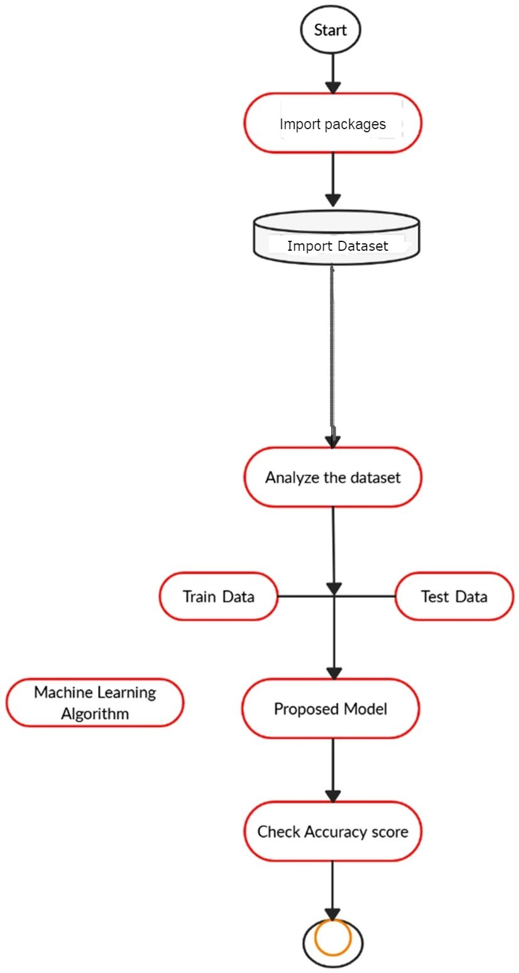
Flowchart

Slide 9

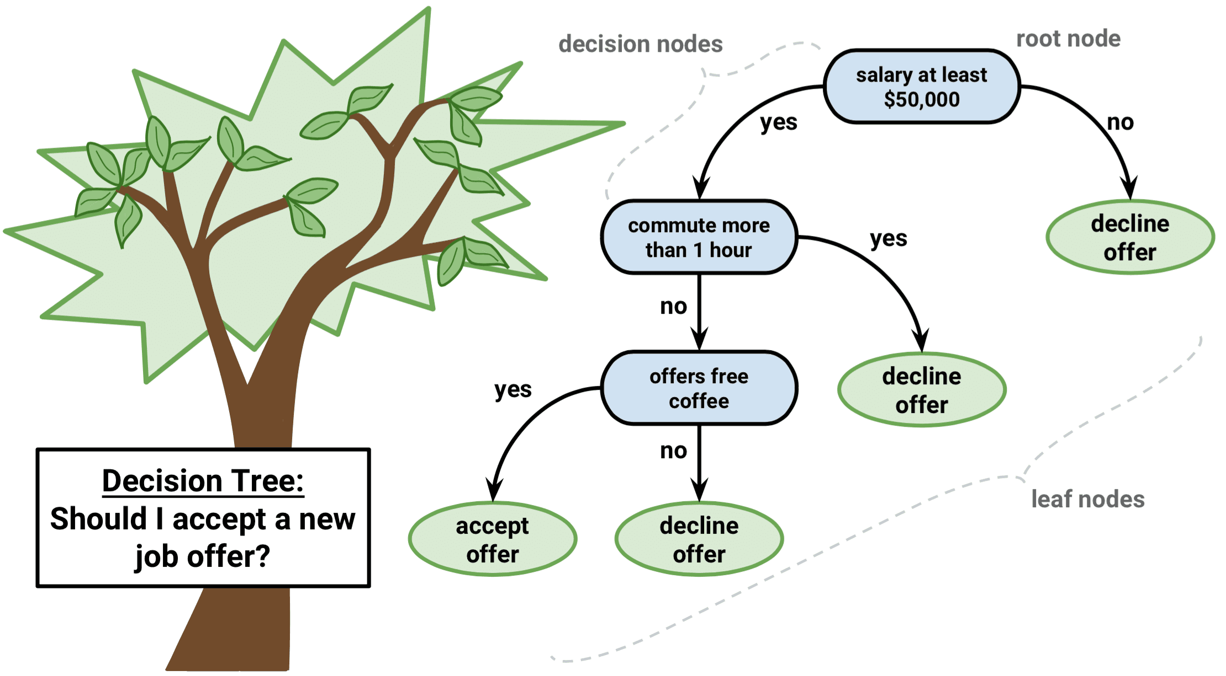

Machine Learning Algorithms
Support Vector Machine
Decision Tree
K-Nearest Neighbors

Slide 10
Decision Tree
It is a tree-structured classifier, where internal nodes represent the features of a dataset, branches represent the decision rules, and each leaf node represents the outcome..​
It is a graphical representation for getting all the possible solutions to a problem/decision based on given conditions.
PROS | CONS
Does not require normalization and scaling of data. | It tends to overfit.
Missing values in the data does not affect the process of building tree | Limiting tree depth.

Slide 11
K - Nearest Neighbors
It is based on a non-parametric method that is used for classification and regression problems.
More contribution is provided by the nearer neighbors, when compared to the distant neighbors.
PROS | CONS
K-NN is intuitive and simple | K-NN is a slow algorithm
Can be used both for Classification and Regression | Choosing optimal number of neighbors

Slide 12
Support Vector Machine
It is a supervised learning model.
Represents the elements of a group as points in space.
PROS | CONS
Used for both classification and regression problems. | Doesn’t perform well for large dataset.
Able to handle high dimensional data. | Only designed for imbalanced data.
Works well with clear margin of separation | Computation, Memory

Slide 13
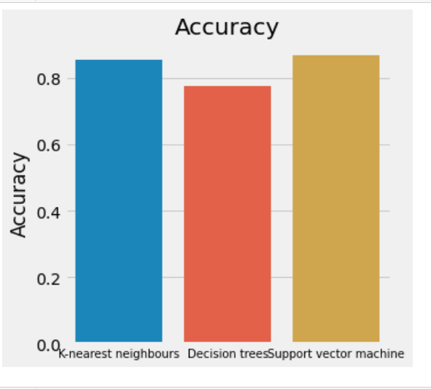
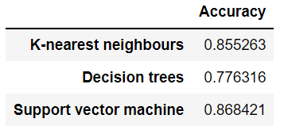

Slide 14
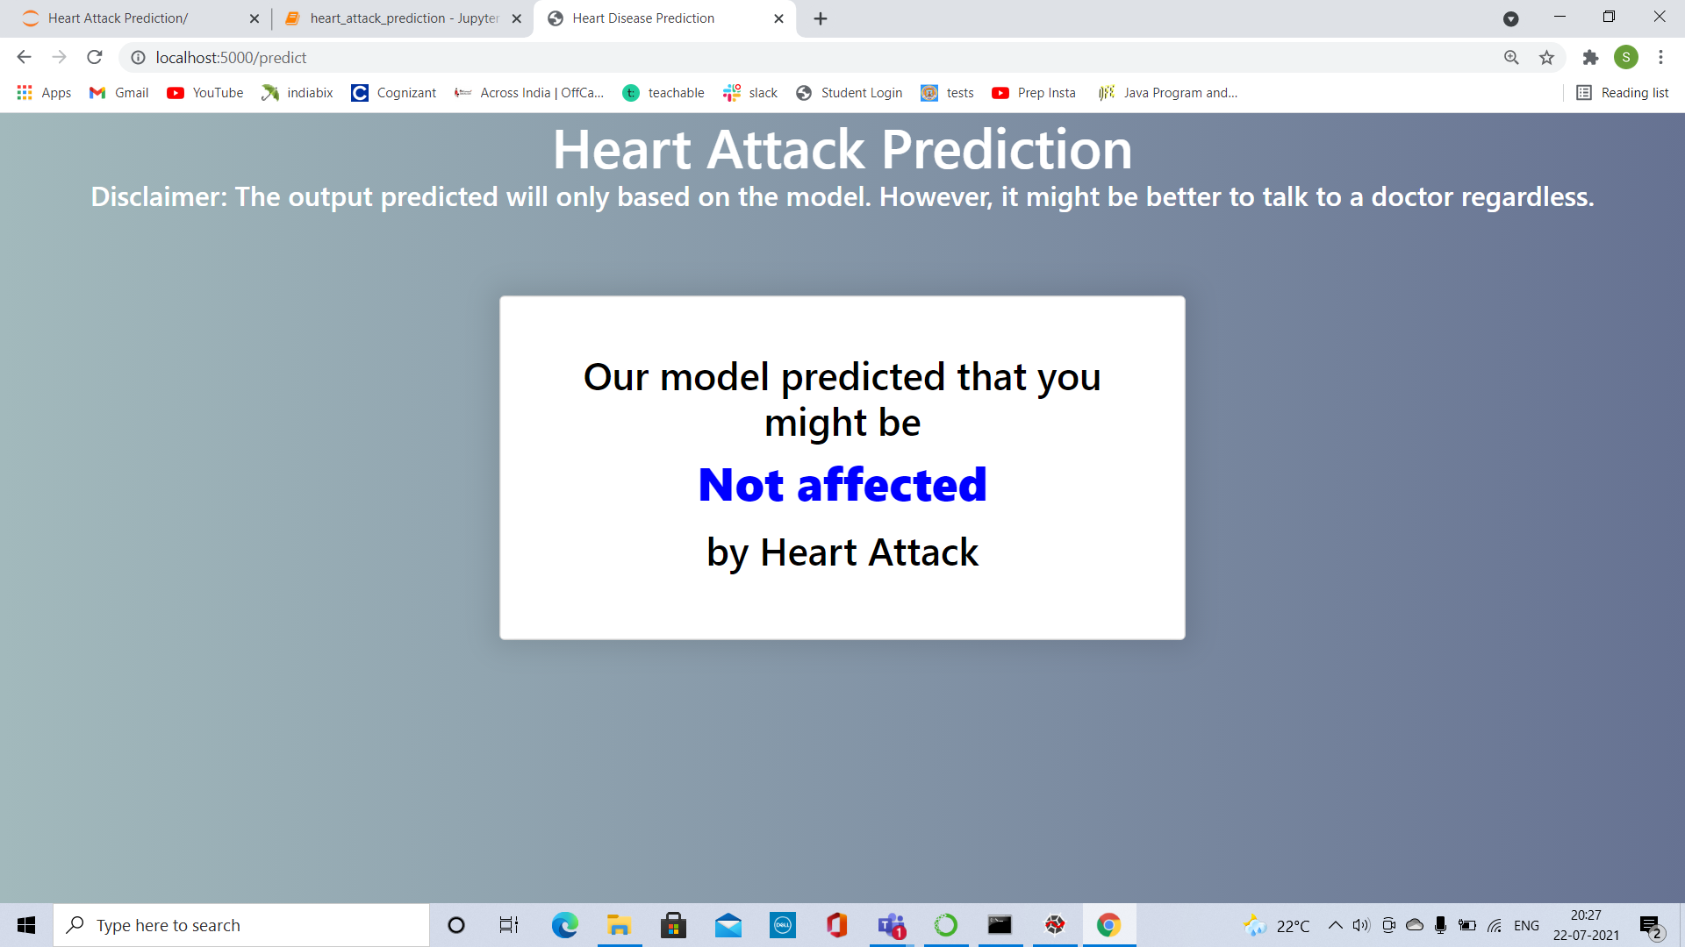

Result

Slide 15

Thanks!

